Slide 1
Statistics
Fundamentals Statistics for Business Analytics
Tushar Anand

Slide 2
Mean, Median, Mode
Mean
The mean is the average of all numbers and is sometimes called the arithmetic mean. To calculate mean, add together all of the numbers in a set and then divide the sum by the total count of numbers.
Median
The statistical median is the middle number in a sequence of numbers. To find the median, organize each number in order by size; the number in the middle is the median.
Mode
The mode is the number that occurs most often within a set of numbers. Mode helps identify the most common or frequent occurrence of a characteristic. It is possible to have two modes (bimodal), three modes (trimodal) or more modes within larger sets of numbers.

Slide 3
Finding mean
A student has gotten the following grades on his tests: 87, 95, 76, and 88. He wants an 85 or better overall. What is the minimum grade he must get on the last test in order to achieve that average?
Let the required marks be x.
Solving for x:
(87 + 95 + 76 + 88 + x) ÷ 5 = 85
87 + 95 + 76 + 88 + x = 425
346 + x = 425
x = 79
Thus, the minimum grade required is 79.

Slide 4
Finding median
Find the median of this data:
10, 40, 20, 50
Put the data in order first:
10, 20, 40, 50
There is an even number of data points, so the median is the average of the middle two data points.
10, {20}, {40}, 50
Median = {20+40} / {2} = 30
The median is 30.

Slide 5
Finding mode
Ms. Rubin asked students in her class how many siblings they each had.
Find the mode of the data: 0, 0, 0, 1, 1, 1, 1, 2, 2, 2, 2, 4
Look for the value that occurs the most: 0, 0, 0, 1, 1, 1, 1, 2, 2, 2, 2, 4
There is a tie for the value that occurs the most often.
The modes are 1 and 2 siblings.

Slide 6
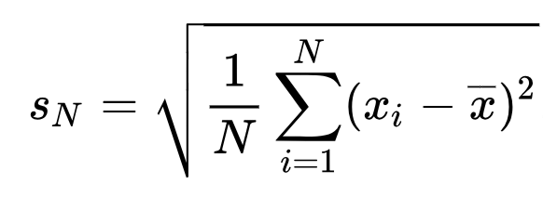
Standard deviation
Standard Deviation is a measure that is used to quantify the amount of variation or dispersion of a set of data values. A low standard deviation indicates that the data points tend to be close to the mean (also called the expected value) of the set, while a high standard deviation indicates that the data points are spread out over a wider range of values.

Slide 7
Continuous & discrete
BASIS FOR COMPARISON | DISCRETE VARIABLE | CONTINUOUS VARIABLE
Meaning | Discrete variable refers to the variable that assumes a finite number of isolated values. | Continuous variable alludes to the a variable which assumes infinite number of different values.
Range of specified number | Complete | Incomplete
Values | Values are obtained by counting. | Values are obtained by measuring.
Classification | Non-overlapping | Overlapping
Assumes | Distinct or separate values. | Any value between the two values.
Represented by | Isolated points | Connected points

Slide 8
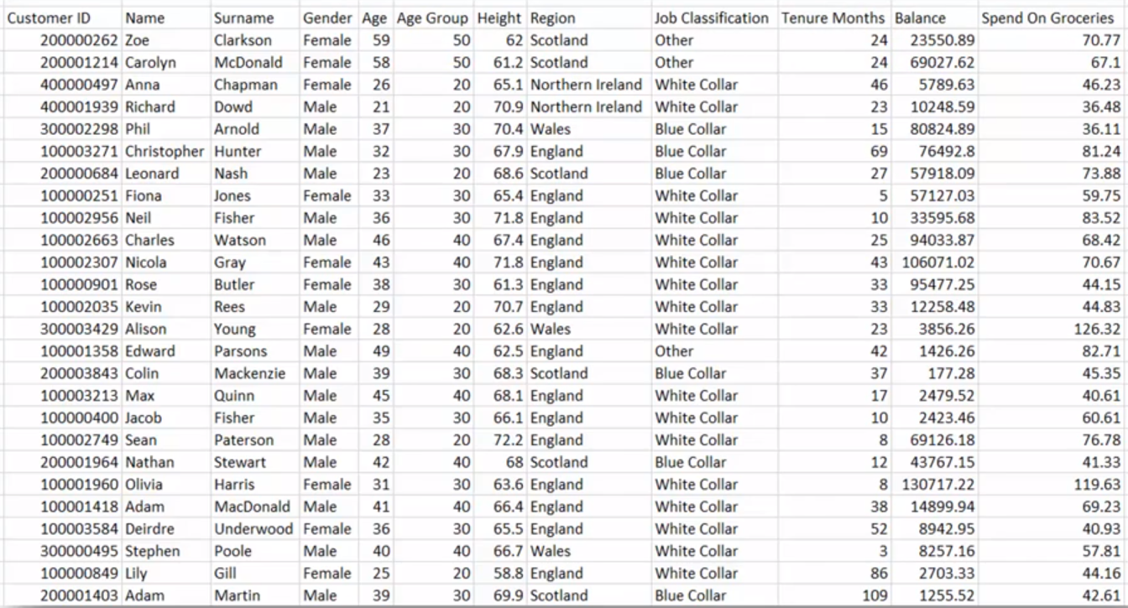

Slide 9
Distribution
In probability theory and statistics, a probability distribution is a mathematical function that provides the probabilities of occurrence of different possible outcomes in an experiment. In more technical terms, the probability distribution is a description of a random phenomenon in terms of the probabilities of events.

Slide 10
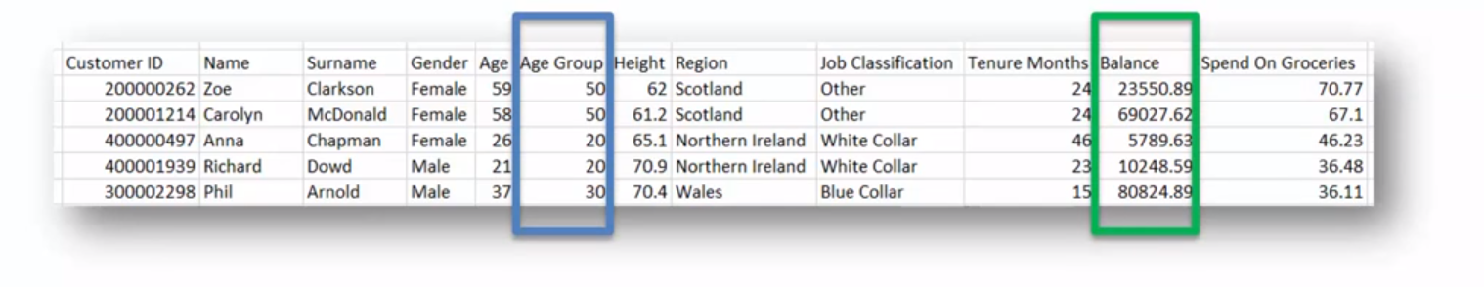
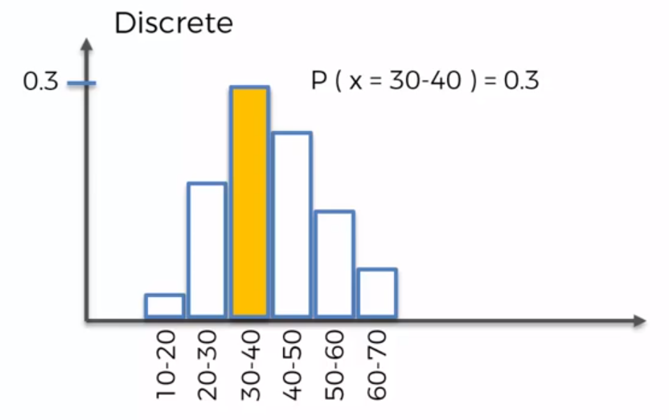
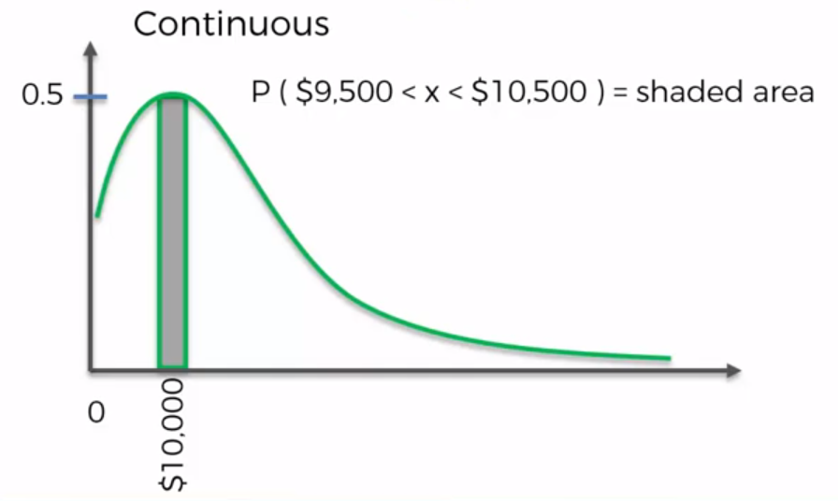

Slide 11
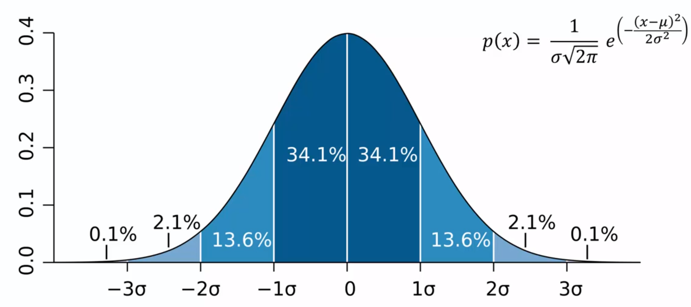
Normal Distribution

Slide 12
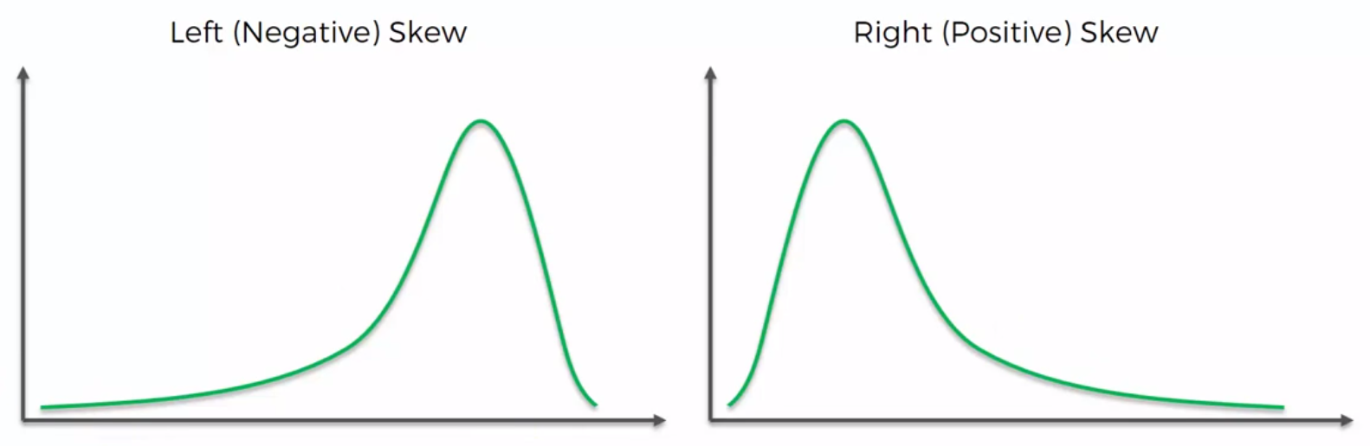
Skewness

Slide 13
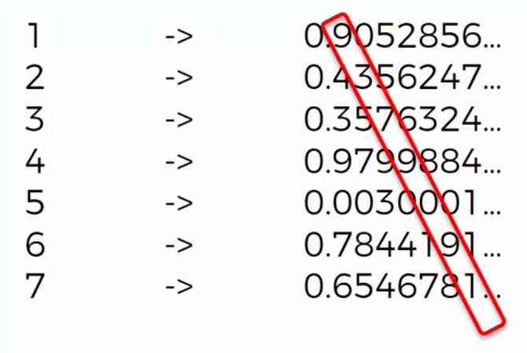
Cantor’s diagonal argument
Cantor's diagonal argument, also called the diagonalisation argument, is a mathematical proof that there are infinite sets which cannot be put into one-to-one correspondence with the infinite set of natural numbers. Such sets are now known as uncountable sets, and the size of infinite sets is now treated by the theory of cardinal numbers which Cantor began.

Slide 14
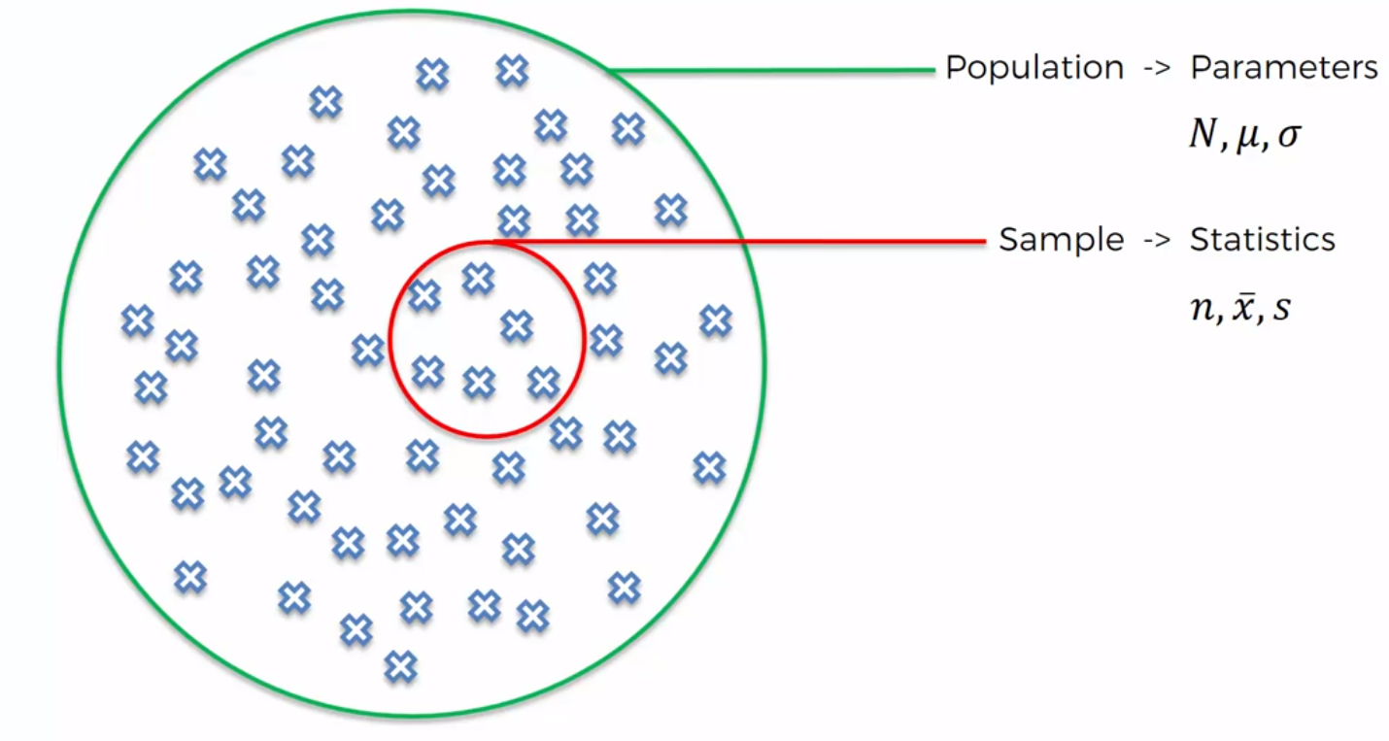
Population & Samples

Slide 15
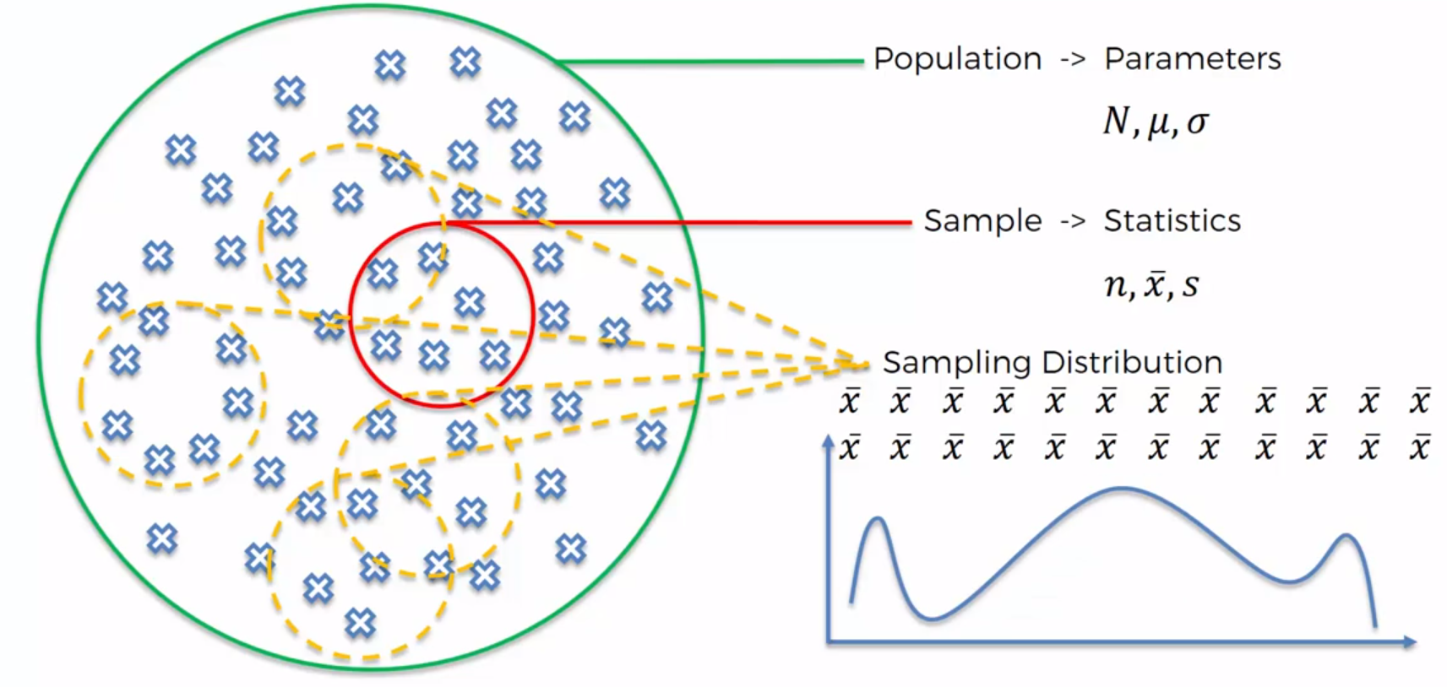
Sampling distribution

Slide 16
Central limit theorem
Given that we take enough samples, the sampling distribution of the sampled mean will be a normal distribution, irrespective of the distribution of the original population.
According to the central limit theorem, the mean of a sample of data will be closer to the mean of the overall population in question as the sample size increases, notwithstanding the actual distribution of the data, and whether it is normal or non-normal.
As a general rule, sample sizes equal to or greater than 30 are considered sufficient for the central limit theorem to hold, meaning the distribution of the sample means is fairly normally distributed.

Slide 17
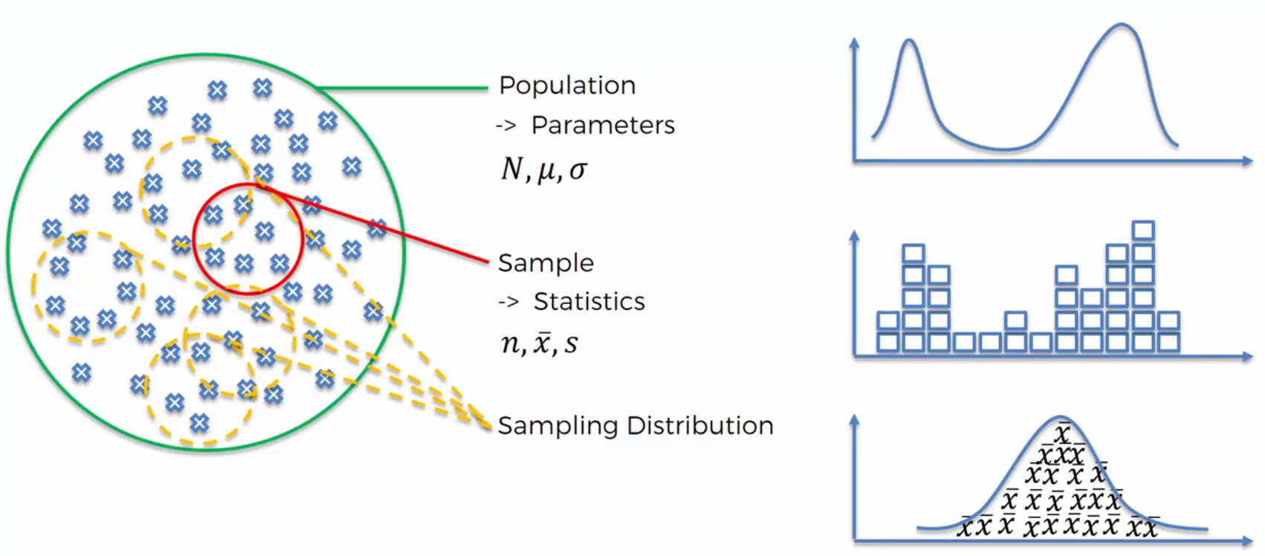

Slide 18
Central Limit Theorem (Visualized)
http://onlinestatbook.com/stat_sim/sampling_dist/index.html

Slide 19
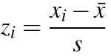
Z-Score
Simply put, a z-score is the number of standard deviations from the mean a data point is. But more technically it’s a measure of how many standard deviations below or above the population mean a raw score is. A z-score is also known as a standard score and it can be placed on a normal distribution curve. Z-scores range from -3 standard deviations (which would fall to the far left of the normal distribution curve) up to +3 standard deviations (which would fall to the far right of the normal distribution curve).

Slide 20
Z Score characteristics
A z-score less than 0 represents an element less than the mean.
A z-score greater than 0 represents an element greater than the mean.
A z-score equal to 0 represents an element equal to the mean.
A z-score equal to 1 represents an element that is 1 standard deviation greater than the mean; a z-score equal to 2, 2 standard deviations greater than the mean; etc.
A z-score equal to -1 represents an element that is 1 standard deviation less than the mean; a z-score equal to -2, 2 standard deviations less than the mean; etc.
If the number of elements in the set is large, about 68% of the elements have a z-score between -1 and 1; about 95% have a z-score between -2 and 2; and about 99% have a z-score between -3 and 3.

Slide 21
Example problem
An FMCG company has requested a large cargo to be transported urgently from New Delhi to Bangalore. When asked about the weight of the cargo, they could not supply the exact weight. However, they have informed us that there are 36 boxes.
From prior experience with this client, you know that this type of cargo follows a Helsinki distribution with a mean of 72 kg and a standard deviation of 3 kg.
There is only one flight through which the cargo can be transported. The maximum weight allowed is 2630 kg.
Based on this information, what is the probability that all the cargo can be safely loaded onto the plane and transported immediately?

Slide 22
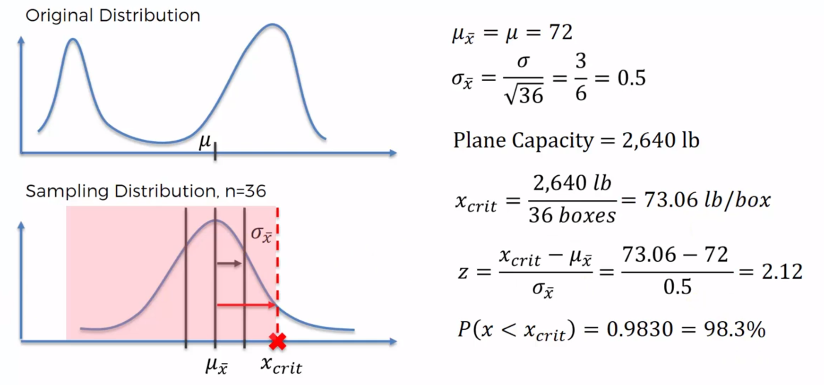
Example problem solution
2630
2630

Slide 23
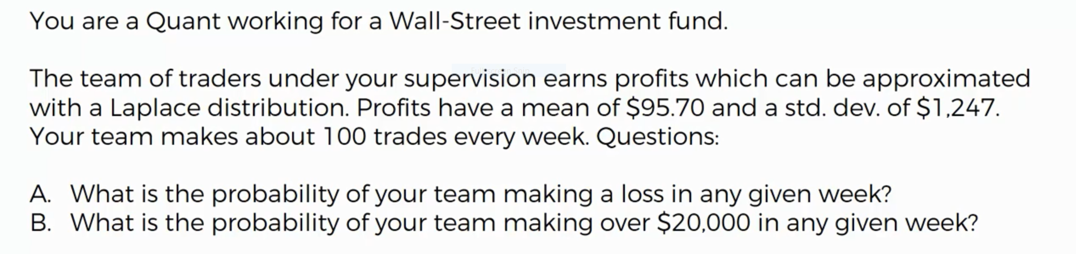
Example problem 2

Slide 24
Statistical Significance
Statistical Significance is the likelihood that a relationship between two or more variables is caused by something other than random chance. Statistical hypothesis testing is used to determine whether the result of a data set is statistically significant. This test provides a p-value, representing the probability that random chance could explain the result; in general, a p-value of 5% or lower is considered to be statistically significant.

Slide 25
Null hypothesis
In the significance testing approach, a null hypothesis is rejected if the observed data are significantly unlikely to have occurred if the null hypothesis were true. In this case the null hypothesis is rejected and an alternative hypothesis is accepted in its place. If the data are consistent with the null hypothesis, then the null hypothesis is not rejected.

Slide 26
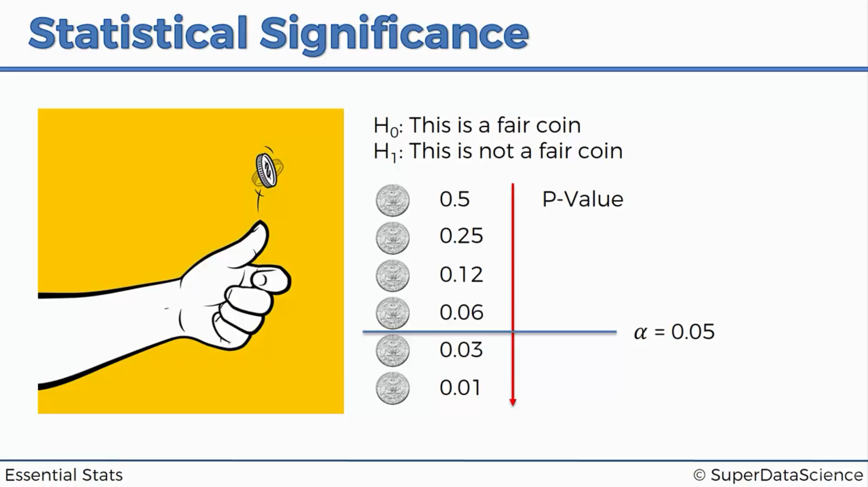
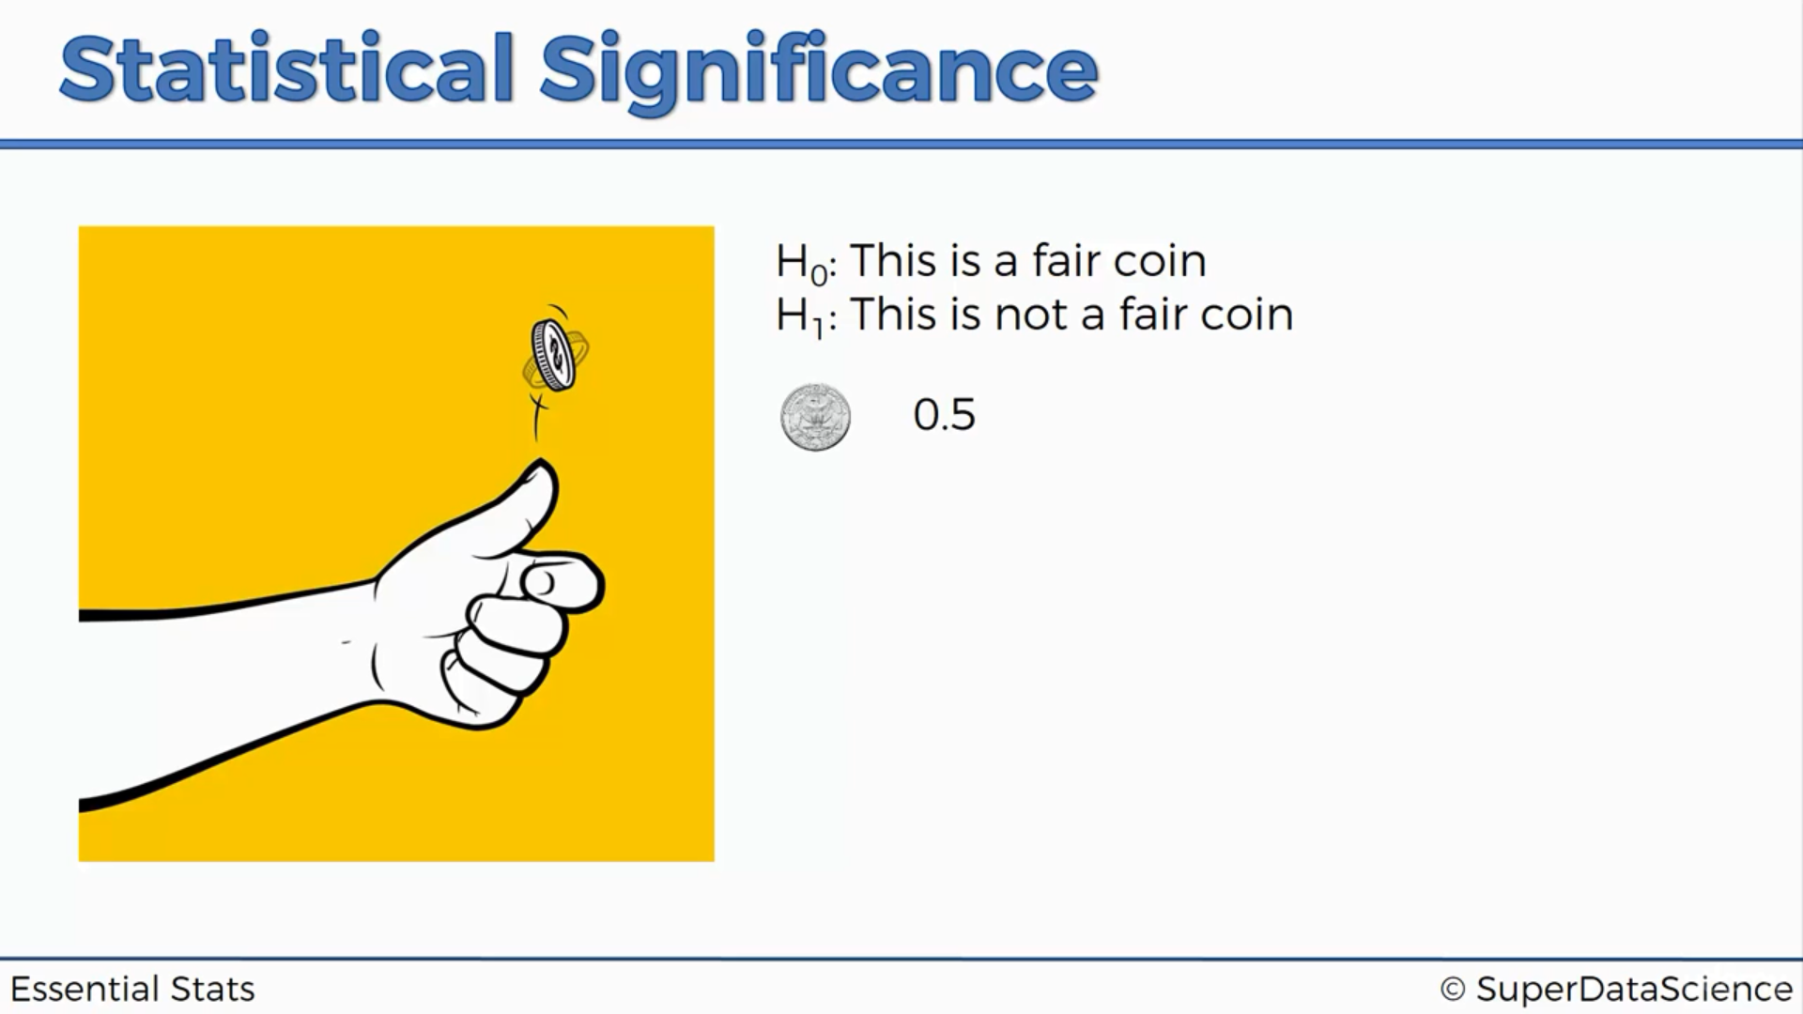

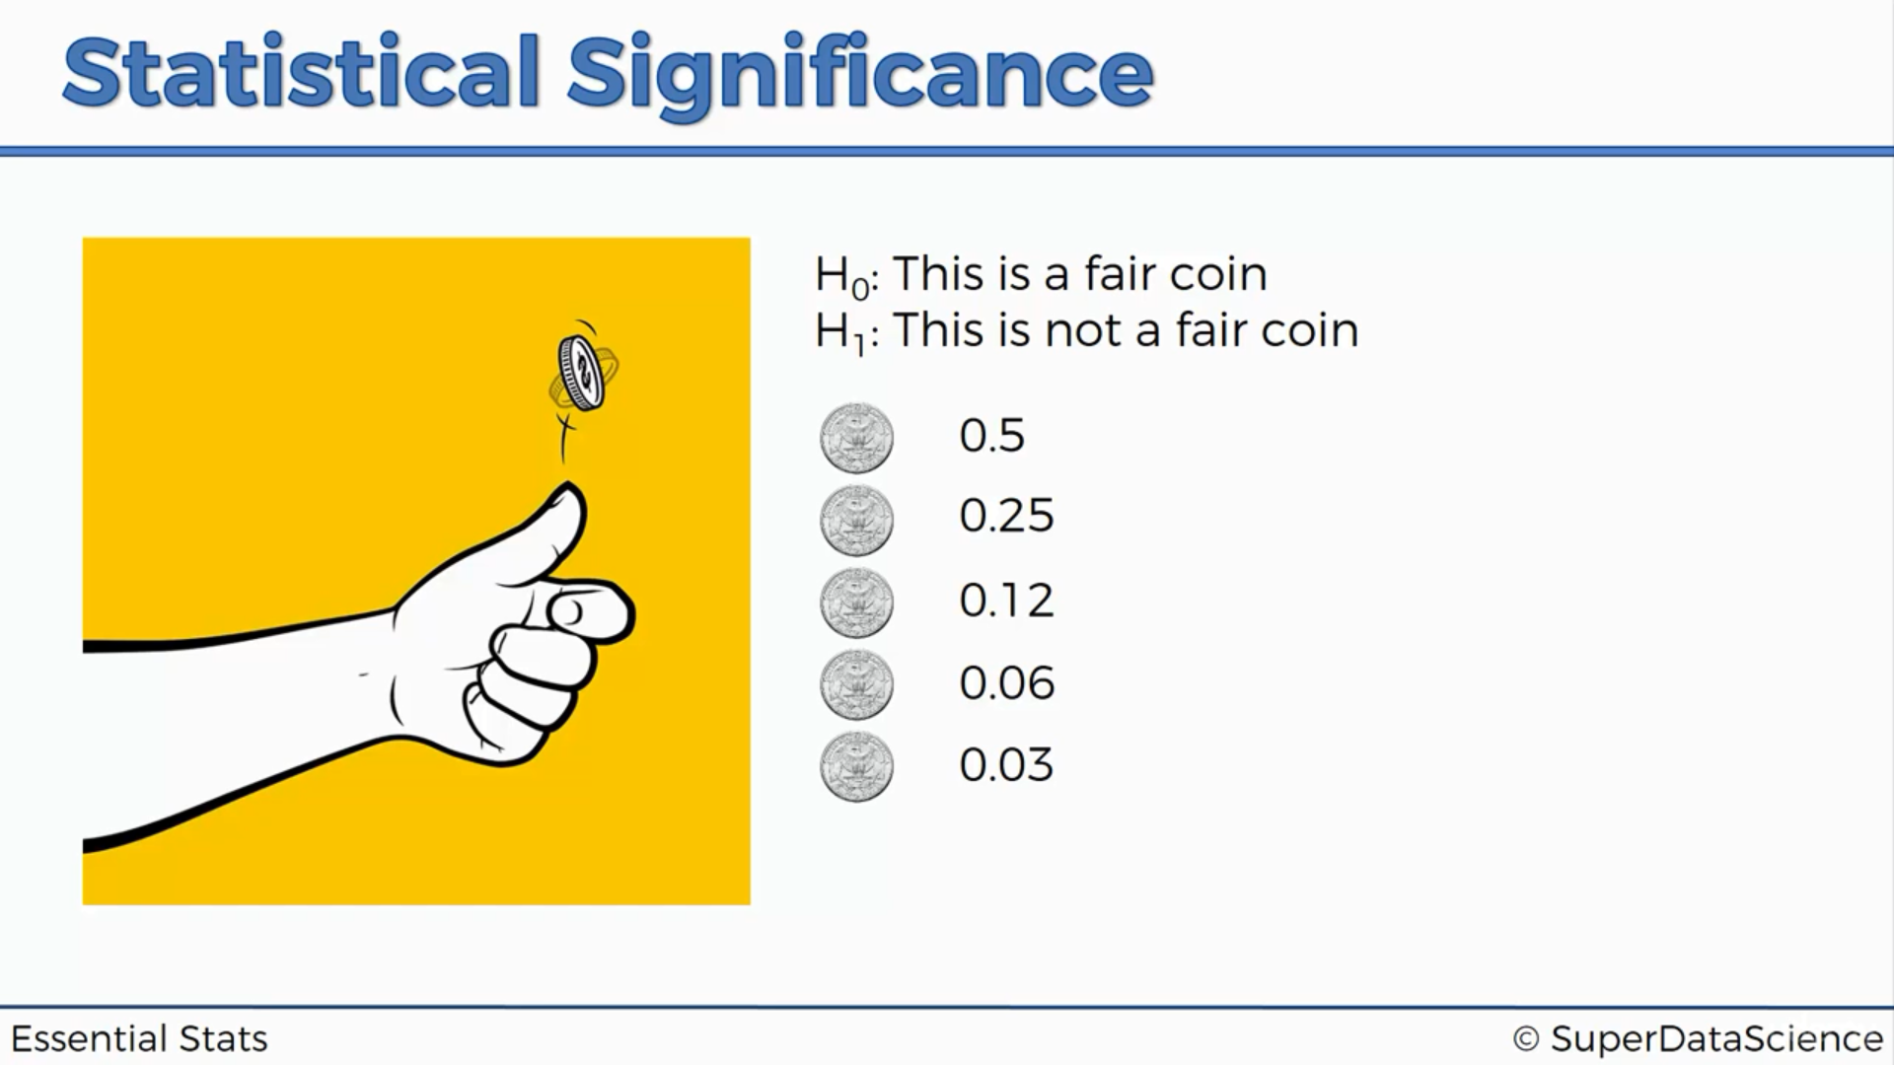

Slide 27
Hypothesis testing
Hypothesis testing in statistics is a way for you to test the results of a survey or experiment to see if you have meaningful results. You’re basically testing whether your results are valid by figuring out the odds that your results have happened by chance. If your results may have happened by chance, the experiment won’t be repeatable and so has little use.

Slide 28
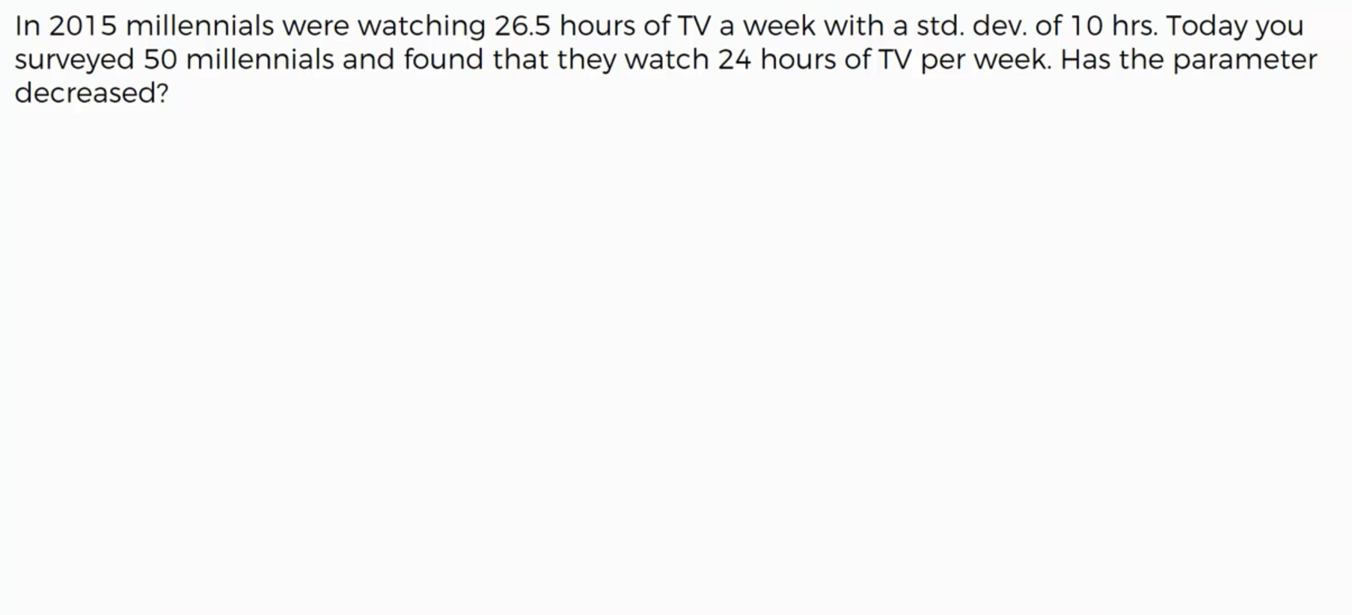
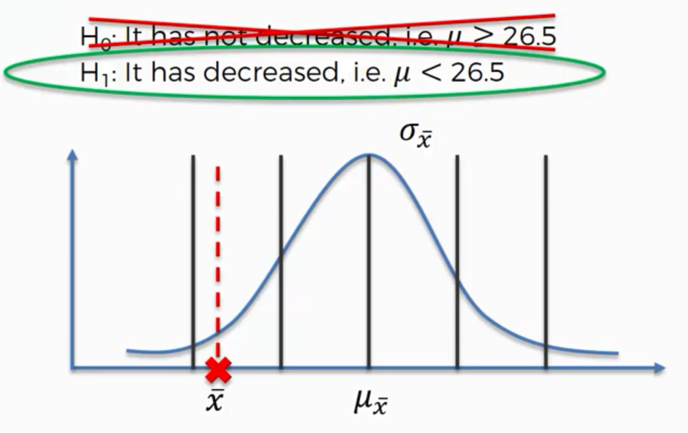
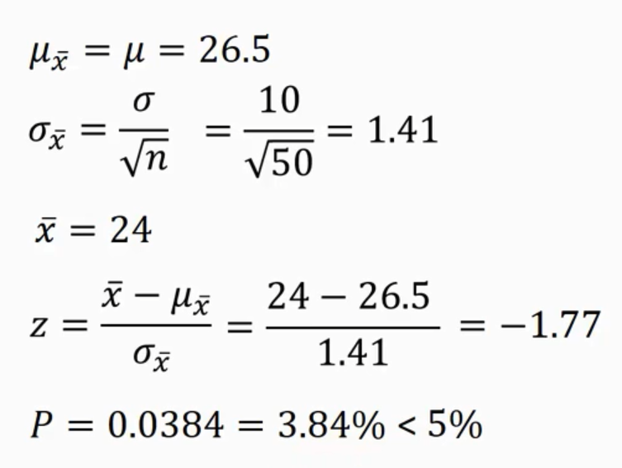
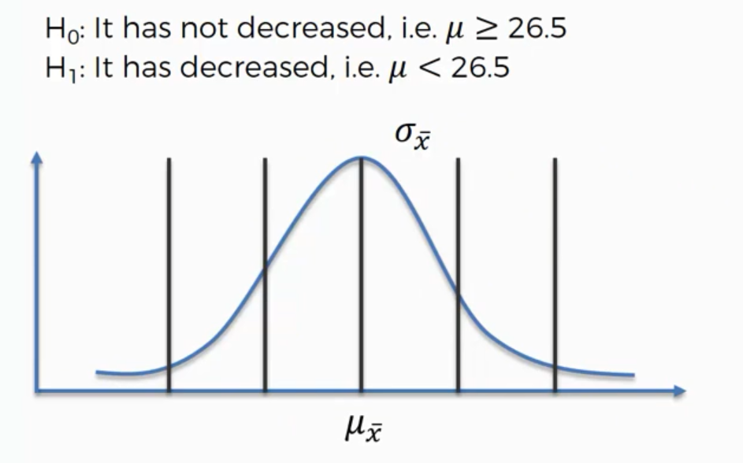

Slide 29
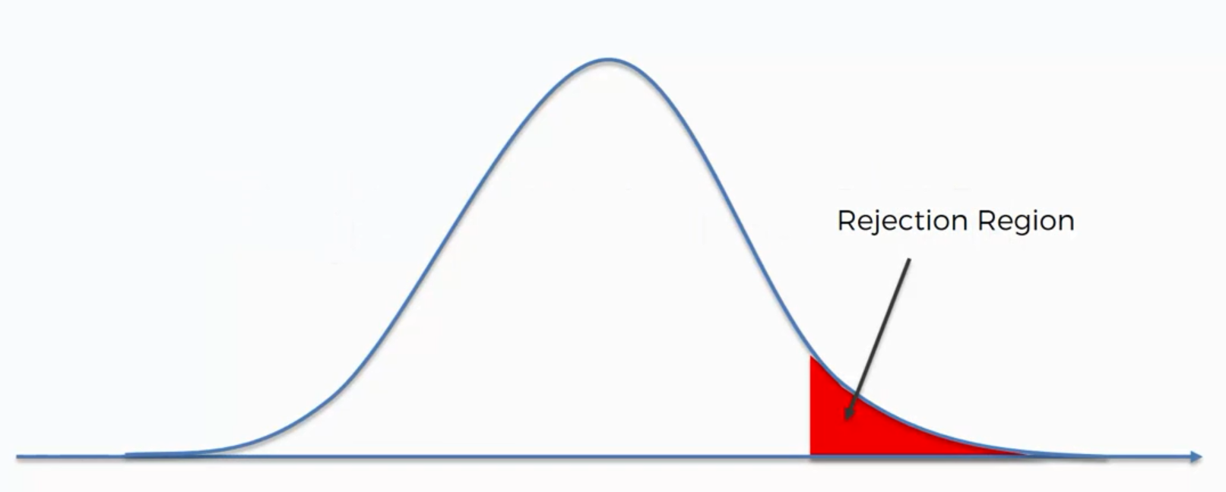
Rejection region

